Slide 1


Azure Security
Notes:
Welcome, and thank you for joining us today. In today’s increasingly complex and evolving cybersecurity landscape and businesses migrate more critical workloads to the cloud, the attack surface continues to expand. With more endpoints, more data, and more complex infrastructures, cyberattacks have become increasingly sophisticated. In fact, reports show that cloud-related security incidents are rising, with data breaches and ransomware attacks being among the most prevalent.
The question isn’t whether you will face security threats, but how prepared you are to deal with them when they happen

Slide 2
MICROSOFT DEFENDER
For Cloud
Microsoft Defender is a comprehensive cybersecurity solution that helps organizations protect their devices, data, and users from cyberattacks
Notes:
So, what exactly is Azure Defender for Cloud?
It’s Microsoft’s comprehensive, cloud-native security solution that provides advanced threat protection for your cloud and hybrid workloads. It goes beyond traditional security tools by offering unified security management and advanced threat detection across your entire IT infrastructure – not just in Azure, but also across hybrid environments and even other cloud platforms like AWS and Google Cloud. With Azure Defender, you’re able to manage security centrally while automating responses to incidents, freeing up your team to focus on what really matters

Slide 3

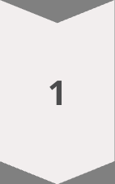
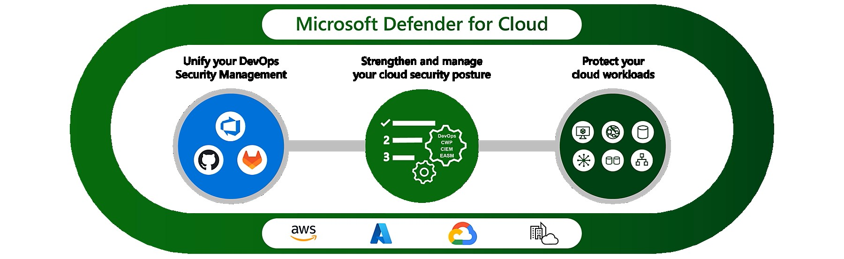
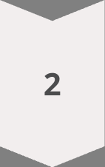
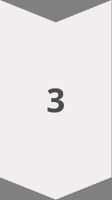
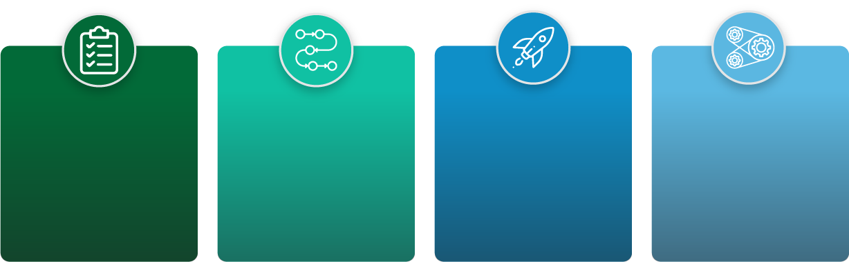

Cloud Security with Microsoft Defender
Cloud Security Posture Management (CSPM)
Provides visibility cloud security posture, identify misconfigurations and vulnerabilities.
Cloud Workload Protection Platform (CWPP)
Protects cloud workloads from attacks, targeting virtual machines and containers.
DevOps Security Management
DevSecOps solution unifying code-level security across multicloud and pipelines
.
Threat Intelligence
Vulnerability Management
Endpoint Detection and Response (EDR)
Access real-time threat intelligence from Microsoft's global network to stay ahead of emerging threats.
Identify and prioritize vulnerabilities across your IT environment, and remediate them proactively
Provides advanced capabilities for detecting, investigating, and responding to endpoint attacks.
Notes:
How Does it Work?
"Azure Defender for Cloud provides layered protection across all critical workloads. Here’s how it works:
Assessment: Azure Defender continually assesses your security posture, offering visibility into potential vulnerabilities and security misconfigurations.
Protection: It proactively monitors and protects all layers of your cloud resources—applications, VMs, databases, storage, containers, and more.
Threat Detection and Response: Azure Defender detects potential security threats using built-in AI and threat intelligence, offering alerts and automated response options to mitigate risks before they become a major issue."_

Slide 4





Key Features & Capabilities
Unified Threat Protection
Advanced Threat Detection
Leverage advanced technologies like machine learning and behavioral analysis to identify and respond to sophisticated threats
Automated Response
Automate threat remediation and incident response tasks to minimize the impact of attacks
Security Posture Management
Gain insights into your security posture and identify vulnerabilities that could be exploited by attackers.
Microsoft Defender provides a unified approach to threat protection, covering endpoints, email, cloud applications, and more.
Notes:
"Let’s dive into some of the key features that make Azure Defender for Cloud so powerful:
Unified Security Management: Azure Defender offers centralized visibility across all your workloads, whether they’re running in Azure, on-premises, or in other clouds.
Advanced Threat Detection: It uses AI and machine learning to detect potential threats early, helping you respond faster to suspicious activities.
Integrated Threat Intelligence: Azure Defender leverages real-time threat intelligence from Microsoft’s global network to protect your cloud resources.
Automated Remediation: By integrating with Microsoft Sentinel and other SIEM tools, you can set up automated responses to security events, reducing the time spent manually addressing incidents.
Compliance Management: Azure Defender helps ensure that your workloads comply with industry standards like PCI DSS, HIPAA, and ISO 27001 by offering continuous monitoring and security recommendations."

Slide 5

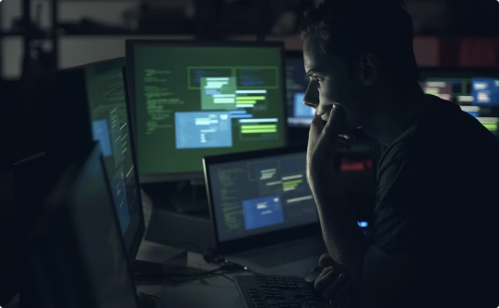

Customer Success Stories
Improved Threat Detection
Reduced Security Incidents
Increased Productivity
Customers have reported significant improvements in their ability to detect and respond to threats.
Microsoft Defender has helped organizations reduce the number of security incidents and minimize their impact.
By automating security tasks, Microsoft Defender has freed up security teams to focus on more strategic initiatives.
Notes:
"Now, let’s take a look at some real-world scenarios where Azure Defender for Cloud excels:
Hybrid Cloud Security: Many organizations operate in hybrid environments with workloads split between on-premises and the cloud. Azure Defender provides seamless protection across both, ensuring that your entire ecosystem is secured.
Container Security: With the rise of containerized applications, securing those containers is crucial. Azure Defender automatically protects your Kubernetes clusters and containerized workloads from vulnerabilities and threats.
Database and Storage Protection: Azure Defender ensures that your most valuable data, whether it’s stored in databases or Azure Storage, is continuously monitored and protected against unauthorized access or exploitation."

Slide 6
AZURE SENTINEL
Azure Sentinel is a cloud-native SIEM that helps you detect and respond to threats across your enterprise.
Notes:
Before we dive into Azure Sentinel, lets understand that organizations are dealing with an explosion of data, cloud services, remote workforces, and complex security threats. Security teams face challenges such as alert fatigue, siloed data, and the increasing sophistication of attacks like ransomware, insider threats, and nation-state actors.
This is where Azure Sentinel, Microsoft’s cloud-native SIEM (Security Information and Event Management) and SOAR (Security Orchestration Automated Response) solution, comes into play. With Azure Sentinel, your organization gains access to advanced threat detection, investigation, and response capabilities—all powered by the intelligence and scalability of the cloud.
Our goal today is to explore how Azure Sentinel can help your organization streamline security operations, enhance threat visibility, and take advantage of automation to respond faster to incidents—all while reducing costs and complexity. Let's dive into how this next-generation security platform can empower your security team to stay ahead of today’s cyber threats.

Slide 7
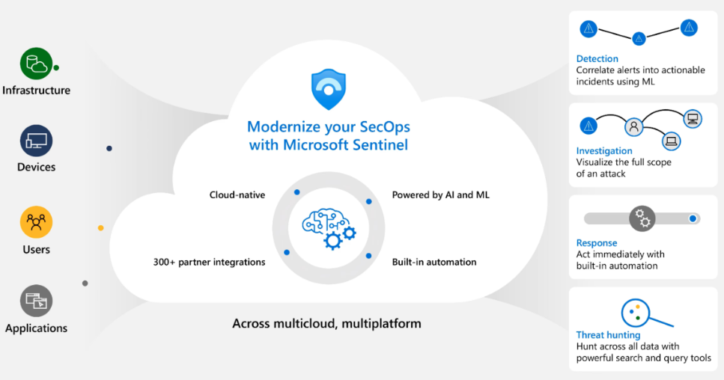

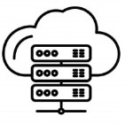







AZURE SENTINEL - Overview
Threat Detection
Security Orchestration
Centralized Security Management
Anomaly detection
Data collection and ingestion
Incident management
Behavioral analysis
Playbook automation
Alerting and reporting
Threat intelligence integration
Threat hunting
Security posture management
Notes:
What is Azure Sentinel?
Speaker: Azure Sentinel is Microsoft’s cloud-native SIEM (Security Information and Event Management) and SOAR (Security Orchestration Automated Response) platform. Unlike traditional SIEMs, Azure Sentinel offers the agility and scalability of the cloud, allowing you to collect data across your entire organization, detect threats, investigate incidents, and respond in real-time.
It offers several key benefits:
Unified Visibility – It aggregates data from all your platforms, including Azure, on-premises systems, and other cloud providers.
Artificial Intelligence and Automation – AI-driven threat detection and automated responses help reduce the workload for your security teams.
Scalability – As a cloud service, Sentinel scales with your business needs without the costs and complexity of traditional on-prem solutions.
Integration – Seamless integration with Microsoft 365, Azure services, and third-party systems ensures you can manage security across your environment from a single pane of glass.

Slide 8




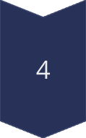


KEY FEATURES Azure Sentinel
Incident Response & Automation
Threat Detection and Investigation
Real-time Threat Detection
Advanced Analytics
Threat Intelligence Integration
Incident Detection
Trigger alerts and notifications based on predefined rules and security events.
Incident Investigation
Monitor and analyze security events in real-time, enabling rapid identification of threats.
Gather and analyze relevant security data to understand the nature and scope of the incident.
Utilize machine learning algorithms to detect unusual patterns and identify potential threats.
Leverage threat intelligence feeds to enrich security data and enhance detection capabilities.
Incident Containment
Implement necessary actions to mitigate the impact of the incident and prevent further damage.
Incident Remediation
Restore affected systems and data to a secure state and implement preventive measures.
Notes:
Core Features of Azure Sentinel
Let’s take a closer look at some of the core features of Azure Sentinel:
Data Collection: Sentinel can collect data from any source, including Microsoft services, other clouds, and on-prem environments. It integrates with over 100 connectors, including popular security tools like Firewalls, endpoint detection systems, and network devices.
Analytics and Threat Detection: Sentinel uses built-in machine learning and AI to detect anomalies and alert you to potential threats. This reduces false positives and allows your team to focus on the real issues.
Investigation and Response: Azure Sentinel provides rich investigation tools, enabling your team to visualize attack timelines, identify root causes, and respond faster to incidents. Through automated playbooks, you can create workflows that respond to specific threats—drastically reducing incident response time.
Hunting Capabilities: For security analysts, Sentinel offers a powerful hunting dashboard where they can query historical data, create custom detections, and proactively search for threats.

Slide 9
Customer Success Stories
Improved Threat Visibility
Enhanced Security Posture
Streamlined Incident Response
Increased Security ROI
Customers have reported significant improvements in threat visibility and detection capabilities.
Azure Sentinel has helped customers strengthen their security posture and reduce their risk profile.
Customers have experienced faster and more efficient incident response processes.
Customers have achieved a positive return on investment through improved security and reduced security costs.
Notes:
To illustrate the impact of Azure Sentinel, let’s talk about a real-world case. [Example Company], a global retail organization, faced challenges with disparate security tools, alert overload, and slow response times. After deploying Azure Sentinel, they integrated all their security data into one platform, leveraged AI to reduce false positives by 60%, and cut down incident response time by 75% using automated playbooks.
This allowed their security team to focus on higher-value activities, rather than being bogged down with manual incident management.

Slide 10
MICROSOFT COPILOT FOR SECURITY
Microsoft Copilot for Security (Copilot for Security) is a generative AI-powered security solution that helps increase the efficiency and capabilities of defenders to improve security outcomes at machine speed and scale
Notes:
Microsoft Copilot for Security (Copilot for Security) is a generative AI-powered security solution that helps increase the efficiency and capabilities of defenders to improve security outcomes at machine speed and scale.
Copilot for Security helps support security professionals in end-to-end scenarios such as incident response, threat hunting, intelligence gathering, and posture management.
Its Designed with integration in mind :-
It offers a standalone experience and also seamlessly integrates with products in the Microsoft Security portfolio. Copilot for Security integrates with products such as Microsoft Defender XDR, Microsoft Sentinel, Microsoft Intune, and other third-party services such as ServiceNow.

Slide 11
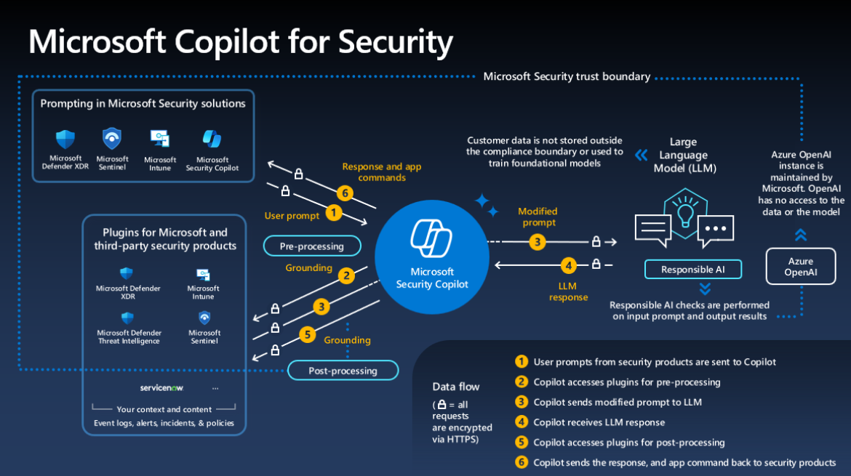
How it Works ?
Improved efficiency
Consistent brand messaging
Reduced errors
Notes:
Here's an explanation of how Microsoft Copilot for Security works:
User prompts from security products are sent to Copilot for Security.
Copilot for Security then preprocesses the input prompt through an approach called grounding, which improves the specificity of the prompt to help you get answers that are relevant and actionable to your prompt. it accesses plugins for preprocessing, then sends the modified prompt to the language model.
Copilot for Security takes the response from the language model and post-processes it. This post-processing includes accessing plugins to gain contextualized information.
Copilot for Security returns the response, where the user can review and assess the response.
Copilot for Security iteratively processes and orchestrates these sophisticated services to help produce results that are relevant to your organization because they're contextually based on your organizational data.

Slide 12
Redington Azure Security Premier League (RASPL)
Categories: -
Max Number of Opportunity Generated * -- Fresh sales ID required
Max revenue generated * -- Valid PO submitted to Redington
Number of launches* – Valid PO submitted to Redington
Opportunity Generated – Slab Mentioned Below
Launches – Slab Mentioned Below
Qualifying Criteria: - (1, 2, 3)
Minimum Qualification criteria is 12 unique customers, or Value should be more than 10k.
Program Terms & Conditions
This is for new customers for Security Service only.
Partners can be Qualified under only one category.
Opportunity and Qualifying Leads should have fresh sales ID (Sales team)
Opportunity submission Period - 1st Dec 2024 to 31st Mar 2025.
*Minimum Qualification criteria is 12 unique customers, or Value should be more than 10k (Applicable for Category 1 , 2 and 3 )
Last date to enroll customers: - 29th Mar 2025
Winners and Runners Announcement date: - 2nd or 3rd week of April 2025.
Customer's acknowledgment is required for enrolling to the program.
The customer acknowledgement mail should be shared with Redington.
Incentive will be in the form of ****
 | Defender | Sentinel | Copilot | Defender + Sentinel | Defender + Sentinel + copilot
Min Security Services MRR for every unique customer in USD | 125 | 350 | 3000 | 400 | 3400

Slide 13
Redington Azure Security Premier League (RASPL)
Category 1, 2 and 3
 | Winner (USD) | Runner (USD)
Number of Opportunity Generated | 500 | 300
Number of launches | 1000 | 600
Max revenue generated | 1000 | 600
Opportunity Incentive (Category 4)
Launch Incentive (Category 5)
MRR Security Services in USD | Unique Customer Per Partner | Incentive in USD
400 | 3 | 20
500 | 5 | 30
MRR Security Services in USD | Unique Customer per Partner | Incentive in USD
400 | 3 | 50
500 | 5 | 80
Notes:
To illustrate the impact of Azure Sentinel, let’s talk about a real-world case. [Example Company], a global retail organization, faced challenges with disparate security tools, alert overload, and slow response times. After deploying Azure Sentinel, they integrated all their security data into one platform, leveraged AI to reduce false positives by 60%, and cut down incident response time by 75% using automated playbooks.
This allowed their security team to focus on higher-value activities, rather than being bogged down with manual incident management.

Slide 14
LET’S START
Notes:
Any Questions
Closing Statement:
That wraps up our presentation today. I hope you’ve found this session valuable, and we look forward to partnering with you on your cybersecurity journey. Thank you!

Slide 15
MICROSOFT COPILOT
Microsoft Copilot is a powerful AI-powered tool designed to enhance customer engagement and improve customer experiences. It leverages the latest in natural language processing and machine learning to understand customer needs and provide personalized assistance.

Slide 16
Key Features
Automated Customer Service
Personalized Recommendations
Enhanced Communication
MOBILIZE
MIGRATE
Copilot can handle basic customer inquiries and requests, freeing up human agents to focus on more complex issues.
Copilot can analyze customer data and provide tailored recommendations for products, services, and content.
Copilot can generate email drafts, social media posts, and other content for effective communication.
24/7 availability
Personalized responses
Multi-channel support
Proactive outreach
Targeted promotions
Improved customer satisfaction
Improved efficiency
Consistent brand messaging
Reduced errors

